Slide 1

Interoperability among different systems in smart city using blockchain.

Slide 2
Contents
The Hybrid Consensus Mechanism - Neighbour Before Authority a) Communications in NBA model b) Working of NBA Model
Distributed Ledger Technology - IOTA a) Tip Selection Algorithms b) Arising problems c) Implementation
Future Scope
References

Slide 3
Neighbour Before Authority (NBA)
THE HYBRID CONSENSUS MECHANISM

Slide 4
An Example of the Hybrid Approach Verification
Traffic System Nodes
Insurance System Nodes
Hospital System Nodes
Size of the circle indicates the stake or weight of a node
Insurance Authority
Local officer with more weight
Traffic
Authority
Hospital Authority

Slide 5
Transaction Structure
Sender Address
(String)
Receiver Address
(String)
SEK(Special Encrypted Bit)
1 Bit
Transaction Payload
Signature
Hash Value
Timestamp
EB(Emergency Bit)
ASV( Acc. Stake Value )
Node Type

Slide 6
Communications in the NBA Model
Communications in the NBA model happen in the form of messages between peers like in any de centralised Network.
The communications happening in the NBA Model are
OFF Ledger Communications
ON Ledger Communications

Slide 7
OFF Ledger Communications
The communications which happen in the network betweens the node of the same type of system
They happen between the local nodes and between the initiator node and authority of the system in the times of need.
The main aim of this type of communication happens to accumulate the stake needed to get the transaction verified.
Once Verified the OFF Ledger communications ends laying ground for the ON Ledger Communication to get into the Picture.

Slide 8
Two cases Arise in the OFF Ledger Transaction
i)After Appending the stake the Neighbouring Nodes send the transaction to the src node ,
Now the source node checks the updates stake value and decides to whether send it to the authority or to append it to the ledger and broadcast the successful addition to the Ledger.
ii)Parallelly while initiating the transaction the timestamp is recorded and is an integral part of the transaction as it proceeds in the network, if the source doesn’t get enough stake in the given time or the verifying neighbour notices that the timestamp upon exceeding the threshold the transaction will be redirected to the authority.

Slide 9
ON Ledger Communication
ON Ledger communication is the term coined for the messages that become part of the ledger upon meeting the verification policies.
These communication are the typical Transactions of the Traditional blockchain that are to be pushed into the ledger maintained by each node.
The off ledger message are transformed into the ON ledger Transaction , initiated by other genesis node of the transaction or the authority according to the respective case.
Each peer will be broadcasting the Transaction to its peers, after appending the transaction to their ledgers.

Slide 10
THE TRAFFIC INCIDENT
An Example Scenario to look into the deeper levels of the working of the NBA Algo.

Slide 11
Traffic System Nodes
Insurance System Nodes
High level Delegate .Node with adequate Computational power and in the pinnacle of the hierarchy of the system organisation.
Hospital System Nodes
Size of the circle indicates the stake or weight of a node
Middle level Delegates in each System .
For eg :-District Traffic corporation Head.
Low Level Delegates in each system,
For eg : - Traffic Police ,Insurance Collector,Ward Boy.

Slide 12
Case - I

Slide 13
Traffic System Nodes
Insurance System Nodes
Hospital System Nodes
Size of the circle indicates the stake or weight of a node

Slide 14
Request Stake
Traffic System Nodes
Insurance System Nodes
Hospital System Nodes
Request Stake
Size of the circle indicates the stake or weight of a node
M
Request Stake
Request Stake

Slide 15
Request Stake
M
Stake value Appended
M
Reply Stake
M

Slide 16
On Ledger Transaction
Tx
Tx
Tx
Tx
Tx
Tx

Slide 17
Case - II

Slide 18
Request Stake
M
Stake value Appended
M
Reply Stake
M

Slide 19
Authority Redirection
Authority
M
Stake value Appended
M
M

Slide 20
On Ledger Transactions Broadcast
Tx
Authority
Tx
Tx
Tx
Tx
Tx

Slide 21
DAG

Slide 22
IOTA
The Tangle, which is the data structure behind IOTA, is a particular kind of directed graph, which holds transactions
Each transaction is represented as a vertex in the graph. When a new transaction joins the tangle, it chooses two previous transactions to approve
Unapproved transactions tips
The strategy for choosing which two tips to approve is very important, and is the key to IOTA’s unique technology

Slide 23
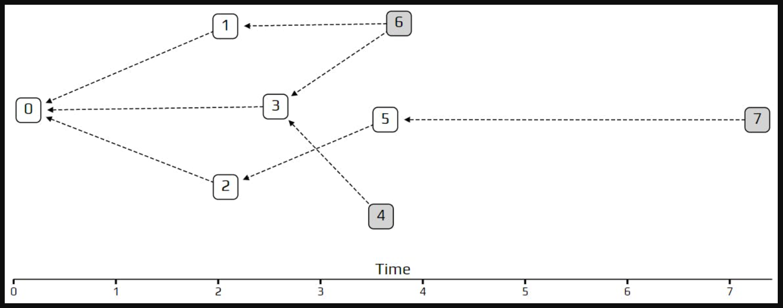
Transaction Rates and Network Latency
Poisson point process models how transactions should arrive

Slide 24
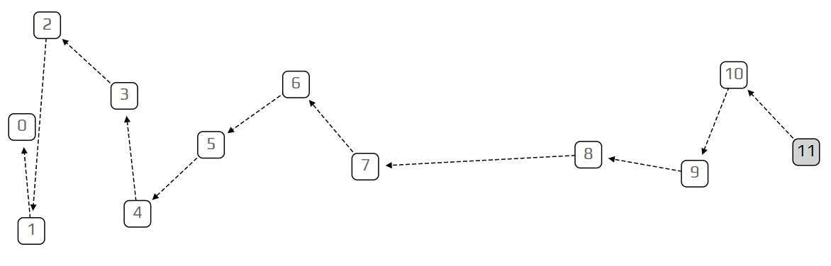
DAG behaves like traditional blockchain when the rate of incoming transactions is very small

Slide 25
Tip Selection Algorithms

Slide 26
Random Walk
At each step it goes to one of the transactions which directly approved the current transaction and chooses the transaction with equal probability

Slide 27
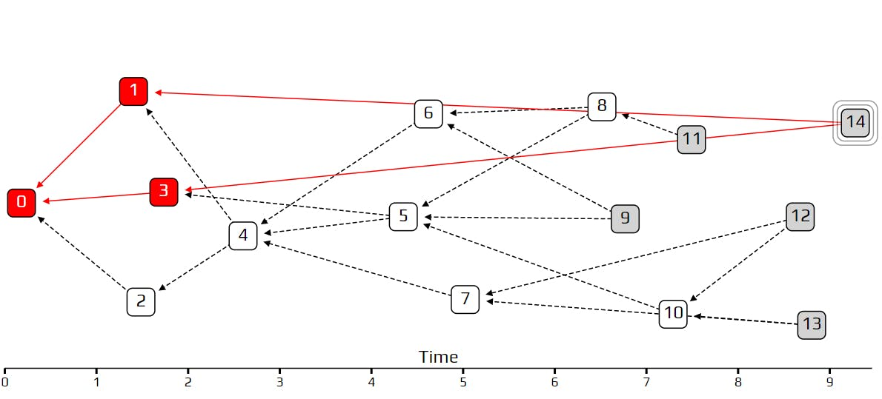
Weighted Random Walk and Cumulative Weight
A lazy tip approves old transactions rather than recent ones. It will only broadcasts its own transactions based on old data.

Slide 28
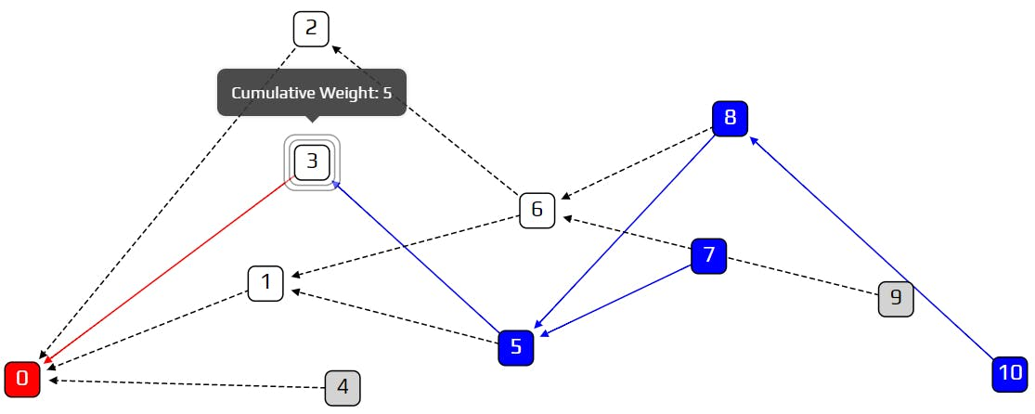
Strategy will be to bias our random walk, so we are less likely to choose lazy tips.
Cumulative weight is count how many approvers a transaction has, and add one.

Slide 29
Here
the problem
arises
How the recent transactions(tip) will get verified?
How the DAG structure would be maintained?

Slide 30
1. Add subsequent transactions with random 2 parents from the latest 5(Based on the Timestamp)
4

Slide 31
2. A) Verify the last transaction
Stakes are verified
Signature of stakeholders are verified
Transactions are verified

Slide 32
2. b) Verify the DAG Structure
Transaction
If parent id present in transaction list
YES
NO
Verification fails
If current transaction timestamp > parent transaction timestamp
NO
YES
Verified successfully
Verification fails

Slide 33
Implementation till now
Implementing the NBA consensus algo in the peer to peer till the local level and sequential stake collection is implemented .
The initiative to implement the parallel stake collection has been taken and implemented in a pseudo manner with the timestamp.
Network verification has been partial implemented.
Implemented the DAG structure using modified tip selection algorithm.
DAG Transaction verification has been partially implemented.

Slide 34
Roadmap To the Future
1
Successfully Implement the Hybrid Consensus Mechanism
2
Address the scalability ,Throughput vs Security concern for a large scale Data.
4
Successfully Making the Blockchain Robust and secure for Realtime.
Simulating the Model for real time Data and testing the Model Blockchain for all scenarios and adapting along with new Blockchain ideas.
3

Slide 35
References
Pervez, H., Muneeb, M., Irfan, M.U. and Haq, I.U., 2018, December. A comparative analysis of DAG-based blockchain architectures. In 2018 12th International conference on open source systems and technologies (ICOSST) (pp. 27-34). IEEE.
Blockchain Technology Concepts and Applications by Kumar Saurabh and Ashutosh Saxena
Raj J.M., Ranjani S.S.
A secured blockchain method for multivariate industrial IoT-oriented infrastructure based on deep residual squeeze and excitation network with single candidate optimizer
Int. Things, 22 (2023), Article 100823
Zhao, Zhenwei, et al. "Secure internet of things (IoT) using a novel brooks Iyengar quantum byzantine agreement-centered blockchain networking (BIQBA-BCN) model in smart healthcare." Information Sciences 629 (2023): 440-455.
ailshery, L.S. IoT Connected Devices Worldwide 2019–2030|Statista. 2022. Available online: https://www.statista.com/statistics/1183457/iot-connected-devices-worldwide/ .
SUI official Documentation https://docs.sui.io/

Slide 36
Thank You
No of Times we met Dr Prashant Sir since the last sem fyp eval to this eval = 6

